Slide 1


Skin Cancer Detection Milestone 1
Nikiraj Konwar, Nicolas Rincon-Speranza, Lawson Darrow, Christian Stevens
Faculty Advisor: Zahra Nematzadeh

Slide 2
Requirements
Functional
Capture & upload images with framing
Classify lesion (benign/malignant) + confidence
Show disclaimers & educational resources
Offline operation; no external storage
Non-Functional
Predictions ≤ 5s
On-device processing (privacy)
Simple & accessible UI
Ethical compliance: not a diagnostic tool

Slide 3
Tool selection
Python & Dart
TensorFlow
NumPy, Pandas, Matplotlib, Pillow, Keras, SciKit Learn
Flutter (iOS & Android)
Platform macOS

Slide 4
Milestone 1 Completion Matrix
Task | Completion % | Lawson | Nick | Christain | Nikiraj | To do
1. Investigate tools | 100% | 25% | 25% | 25% | 25% | none
2. Hello World demos | 100% | 70% | 10% | 10% | 10% | none
3. Requirement Document | 100% | 0% | 100% | 0% | 0% | none
4. Design Document | 100% | 0% | 0% | 0% | 100% | none
5. Test Plan | 100% | 0% | 0% | 100% | 0% | none
6. Implement, test & demo | 100% | 70% | 10% | 10% | 10% | none

Slide 5
Test Plan
Test Case Scenarios for Functional Requirements
Capture lesion with camera
Upload from gallery
Navigate with guidance overlays
Data preprocessing
Image classification
Confidence display
Disclaimers

Slide 6
Test Plan
Test Case Scenarios for Non-Functional Requirements
Latency <5s
Local processing
Accessibility support
Error handling

Slide 7
Resolve Technical Challenges
Improving model accuracy
Data augmentation, model synthesis, reinforcement learning, etc.
Specificity & Sensitivity analysis
Inference time improvements
Image processing pipeline
Security best practices (authentication, encryption, etc.)
Mobile integrations for both iOS and Android

Slide 8
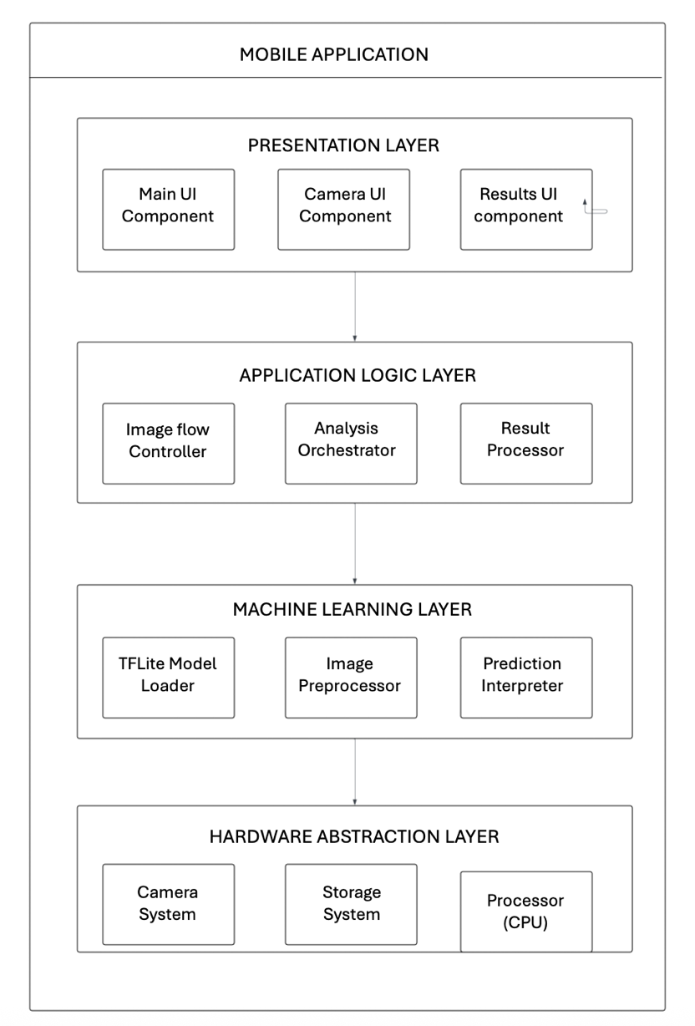
System Overview
The Skin Cancer Detection Mobile Application comprises four major subsystems that work collaboratively to deliver the complete user experience.
Image Capture Module
Machine Learning Inference Engine
Results Processing and Display
Data Management System

Slide 9
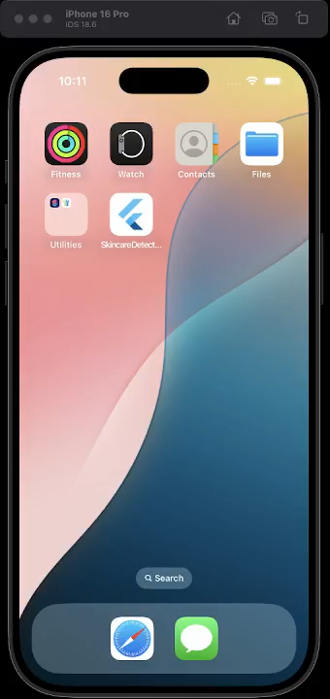
App Demo
Flutter app interface
Camera button
Gallery access w/ image selection
Analysis (coming soon!)

Slide 10
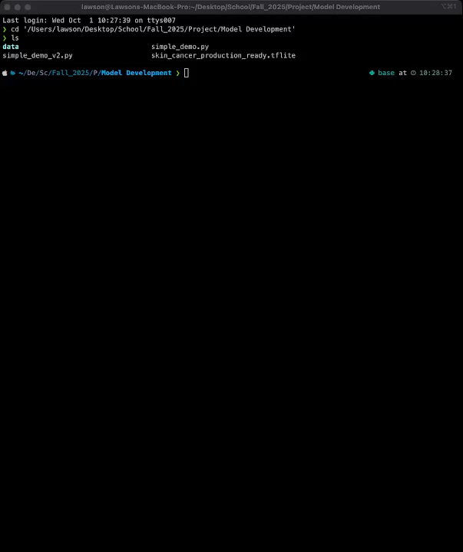
Model Demo
Two ”Hello World” demo’s
Simple_demo.py
4 random validation images
Initial prediction
Check for correctness
Simple_demo_v2.py
8 random test images
Corresponding validation images
Validation (Ground Truth)
Prediction
Risk level
Inference time
Accuracy score
Recommendation

Slide 11
Milestone 2 Task Matrix
Task | Lawson | Nick | Christain | Nikiraj
1. Implement, test, and demo image capture and upload feature with UI framing assistance | Lead development of capture and overlay module | Support testing with different image types | Validate consistency of captured images and report bugs | Document capture workflow and assist with debugging
2. Implement, test, and demo real-time AI-powered prediction feature (integrated TensorFlow Lite CNN model) | Lead integration of TFLite CNN into iPhone app | Assist with connecting preprocessing pipeline | Run performance tests on phone hardware (speed, memory usage) | Verify prediction outputs, confidence display, and error handling
3. Implement, test, and demo disclaimer and educational resource integration (user guidance, preventive info, professional links) | Support UI layout for disclaimers on phone screens | Draft and refine disclaimer wording and educational text | Lead integration of disclaimers and resource links into the iOS app | Test readability, accessibility features
4. Validate prototype with test images and document early usability findings | Run live demos on iPhones and gather user impressions | Lead writing of usability report with structured findings | Conduct systematic testing with edge-case images | Lead analysis of feedback and propose refinements for next milestone

Slide 12

Thank you!

